Slide 1


Hip Apophyseal Injuries in Adolescents
Diego Herrera, DO, CAQSM
Northside Hospital Orthopedics Soccer Medicine Program

Slide 2

What is an apophyseal injury?
Physis = growth plate
Apophysis = involves a growth plate and bony attachment of a tendon or ligament
Apophysitis = inflammation/irritation of the growth plate at the specific bony attachment of a tendon or ligament
Apophyseal avulsion = abnormal separation of the bony attachment of a tendon or ligament from injury

Slide 3
Pelvic Apophyses
Often present during the ages 11-18
Most injuries occur during adolescence between ages 14 and 18
Weakest point of attachment, so more likely first to become injured before a muscle or tendon

Slide 4
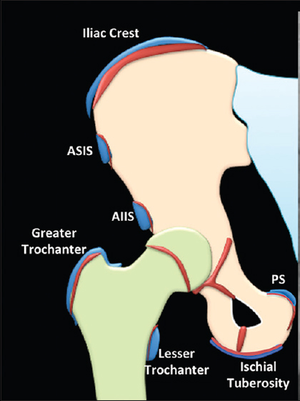
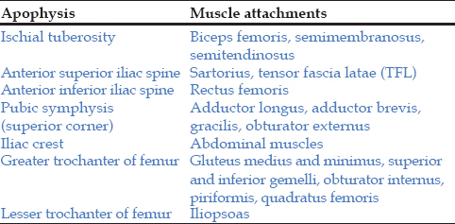
Pelvic Apophyses

Slide 5
Symptoms
Apophysitis
  Localized pain to the particular apophysis
  Pain may start with only activity but can progress to be present at rest
  Can sometimes feel like a strained muscle
Apophyseal avulsion fracture
  Sharp, sudden pain localized at the apophysis
  May feel a “pop” or “crack” with the injury
  Can cause difficulty weightbearing

Slide 6
Diagnosis
Best if athletes evaluated by a sports medicine physician
Can be diagnosed clinically with or without x-rays
X-rays are helpful to make sure there is no acute abnormality of the apophyses
MRI not always needed but can be helpful if x-rays normal and high suspicion for minimally displaced avulsion fracture

Slide 7
Apophysitis Treatment
Relative rest
  “Let pain be your guide”
  Avoid activities that cause pain
Physical therapy
  Work on muscle imbalances that could be causing more stress on the apophyses

Slide 8
Apophyseal Avulsion Fracture Treatment
Good news, usually nonoperative treatment
Rest
  May need to be non-weightbearing for a week or two with crutches
Physical therapy
Return to Sport
  Varies with each case
  Can take on average 8-12 weeks to return to play
Other possible treatments if refractory
  Platelet Rich Plasma (PRP) injection

Slide 9
Take Home Points
Early intervention is key to avoid more severe injury!
Apophyses are weak points of tendon attachments to bone
  Adolescents are more likely to injure apophyses than have a muscle strain or tendinitis
Apophysitis can be present with overuse and sometimes be bad enough to keep soccer players out of training and games
Treatment is usually relative rest and physical therapy
Reach out to your NHO soccer medicine physician for diagnosis, treatment, and soccer-specific return to play guidelines!

Slide 10
Northside Hospital Orthopedics – Soccer Medicine Program
Northside Hospital Orthopedics Soccer Medicine Program
https://www.northside.com/sportsmedicinespecialists/services/soccer-medicine-program

Slide 11
References
Calderazzi F, Nosenzo A, Galavotti C, Menozzi M, Pogliacomi F, Ceccarelli F. Apophyseal avulsion fractures of the pelvis. A review. Acta Biomed. 2018;89(4):470-476. Published 2018 Nov 15. doi:10.23750/abm.v89i4.7632
Reproduced under Open Access charter from: Tyagi V, Milla S. Apophyses and physeal equivalents in the pediatric pelvis. Available from: https://dx.doi.org/10.4103/2319-2585.155908. Journal of Orthopaedics and Allied Sciences (https://joas.org.in)

