Slide 1


Knee, Ankle, and Foot Apophysis Injury in Children and Adolescents
Diego Herrera, DO, CAQSM
Northside Hospital Orthopedics Soccer Medicine Program

Slide 2

What is an apophyseal injury?
Physis = growth plate
Apophysis = involves a growth plate and bony attachment of a tendon or ligament
Apophysitis = inflammation/irritation of the growth plate at the specific bony attachment of a tendon or ligament
Apophyseal avulsion = abnormal separation of the bony attachment of a tendon or ligament from injury

Slide 3
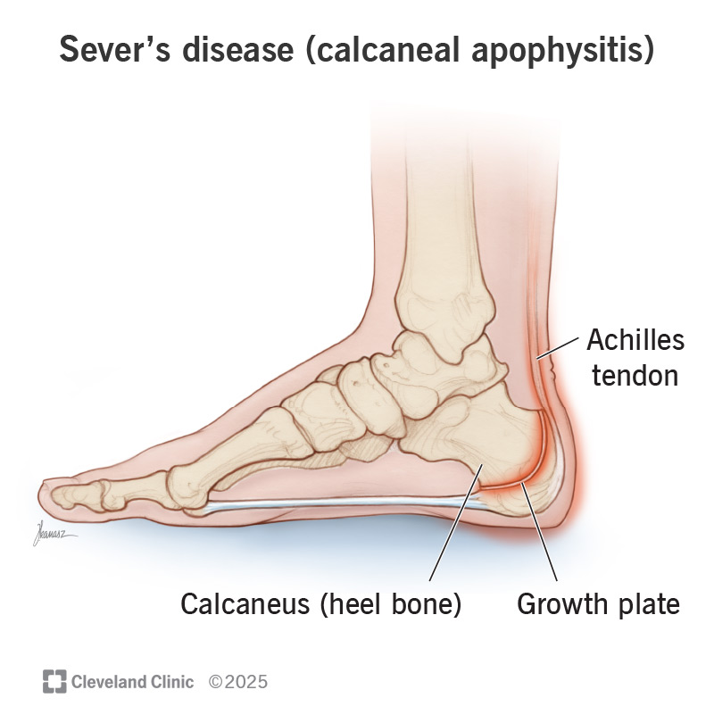
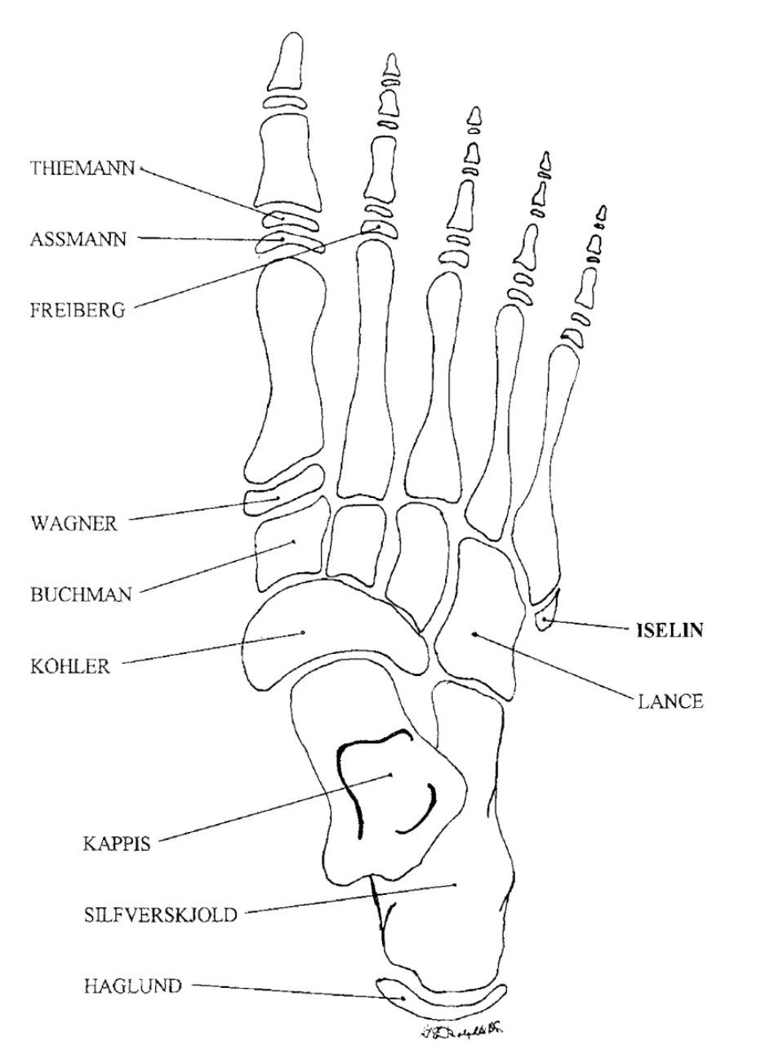
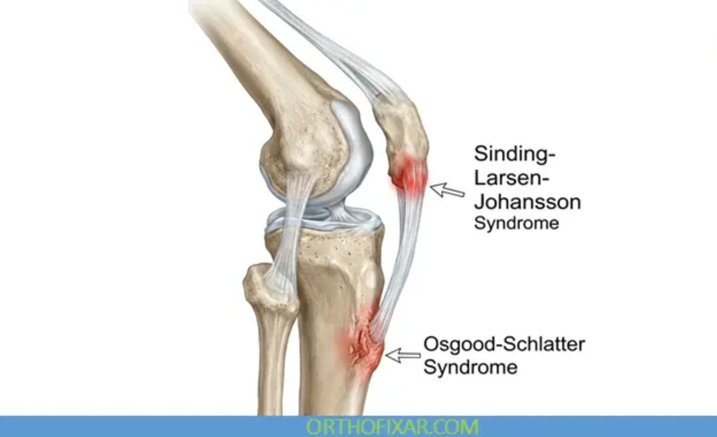
Apophyses of Knee, Ankle, and Foot

Slide 4
Apophyses of Knee, Ankle, and Foot
Sinding-Larsen-Johansson Disease
  Inferior pole of the patella (bottom part of kneecap)
  Adolescents during periods of rapid growth
Osgood-Schlatter Diease
  Proximal tibia, tibial tuberosity (top of shin bone)
  Adolescents during periods of rapid growth
Sever’s Disease
  Posterior calcaneus starting at insertion of Achilles’ tendon (heel growth plate)
  Usually in middle school age children
Iselin’s Diease
  Base of 5th metatarsal (outside of foot)
  Adolescents

Slide 5
Symptoms
Apophysitis
  Localized pain to the particular apophysis
  Pain may start with only activity but can progress to be present at rest
  Can sometimes feel like tendinitis
Apophyseal avulsion fracture
  Sharp, sudden pain localized at the apophysis
  May feel a “pop” or “crack” with the injury
  Can cause difficulty weightbearing

Slide 6
Diagnosis
Best if athletes evaluated by a sports medicine physician
Can be diagnosed clinically with or without x-rays
X-rays are helpful to make sure there is no acute abnormality of the apophyses
MRI not always needed but can be helpful if x-rays normal and high suspicion for minimally displaced avulsion fracture

Slide 7
Apophysitis Treatment
Relative rest
  “Let pain be your guide”
  Avoid activities that cause pain
Immobilization
  Boot or ankle brace for foot and ankle rest if needed
  Crutches for a few days to a week if needed
Physical therapy
  Work on muscle imbalances that could be causing more stress on the apophyses

Slide 8
Apophyseal Avulsion Fracture Treatment
Rest
  May need to be non-weightbearing for a week or two with crutches
Immobilization
  Walking boot or brace
Physical therapy
Return to Sport
  Varies with each case
  Can take on average 8-12 weeks to return to play
Other possible treatments if refractory
  Platelet Rich Plasma (PRP) injection

Slide 9
Take Home Points
Early intervention is key to lower risk of more severe injury!
Apophyses are weak points of tendon attachments to bone
  Adolescents are more likely to injure apophyses than have a muscle strain or tendinitis
Apophysitis can be present with overuse and sometimes be bad enough to keep soccer players out of training and games
Treatment is usually relative rest and physical therapy
Reach out to your NHO soccer medicine physician for diagnosis, treatment, and soccer-specific return to play guidelines!

Slide 10
Northside Hospital Orthopedics – Soccer Medicine Program
Northside Hospital Orthopedics Soccer Medicine Program
https://www.northside.com/sportsmedicinespecialists/services/soccer-medicine-program

Slide 11
References
Gregory A. Pediatric Musculoskeletal Injuries and Conditions. In: Harrast, MA, Finnoff JT. Sports Medicine: Study Guide and Review for Boards, Third Edition. New York, NY: Springer Publishing Company: 2021: 358-366
Schleihauf A. Iselin’s Disease. Sports Med Review. December 12, 2021. Accessed August 5, 2026. https://www.sportsmedreview.com/blog/iselins-disease/
Sever’s Disease (Calcaneal Apophysitis): What Is It, Symptoms & Treatment. Accessed August 5, 2026. https://my.clevelandclinic.org/health/diseases/21176-severs-disease-calcaneal-apophysitis
OrthoFixar. Sinding-larsen-johansson syndrome: Causes, symptoms & treatment. OrthoFixar Orthopedic Surgery. May 23, 2026. Accessed August 5, 2026. https://orthofixar.com/pediatric/sinding-larsen-johansson-syndrome/

