Slide 1



Injury Risk Reduction Warm Up
Northside Hospital Orthopedics Soccer Medicine Program

Slide 2
Purpose
Ensure our athletes properly warm up and reduce risk of injury
Warm up should include movements and intensities that will be experienced during a competitive game

Slide 3
Training Day Warm Up
FIFA 11+
  Combination of FIFA 11 and PEP Program
Best if done twice a week
Shown to reduce training injuries by 37% and match injuries by about 30%
Also shown to reduce severe injuries overall by 50%

Slide 4
FIFA 11+
Takes 20 minutes to complete and can be used as the warm up for training
Running exercises – 8 minutes: encompassing cutting, change of direction, decelerating and proper landing techniques
Strength, plyometric and balance exercises – 10 minutes: focus on core strength, eccentric control and proprioception
Running exercise – 2 minutes: high-speed and change-of-direction running

Slide 5
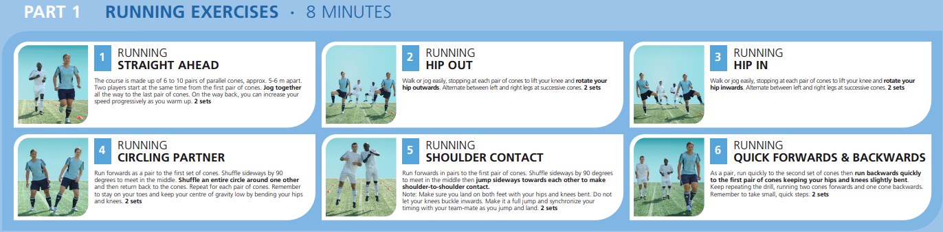

Slide 6
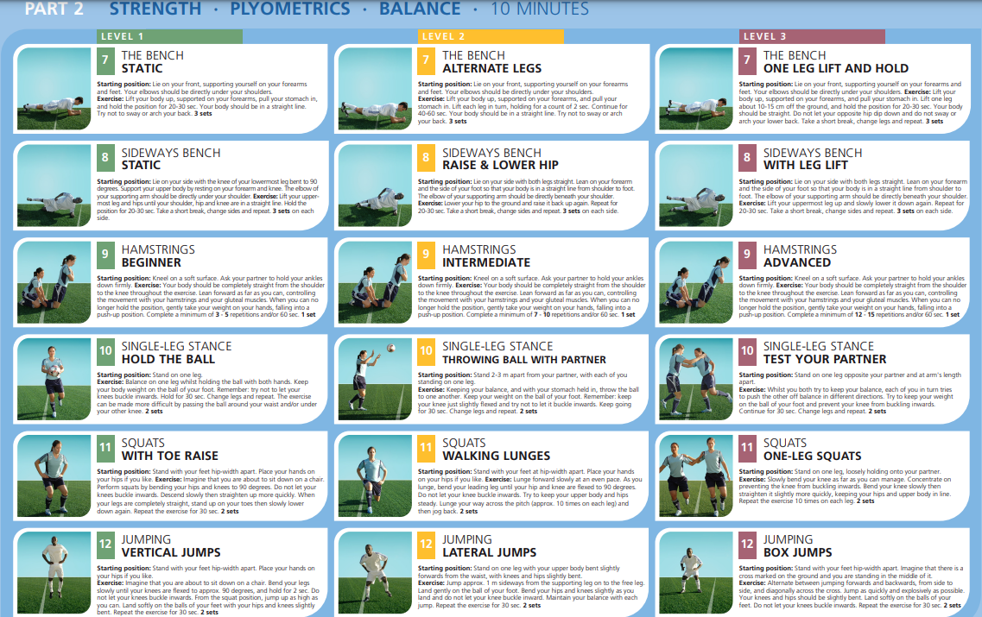

Slide 7
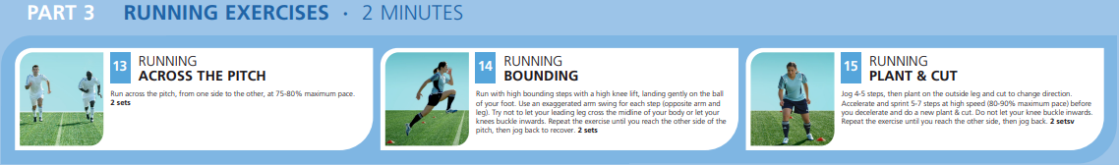

Slide 8
Prevent Injury and Enhance Performance (PEP) Program
Another warm up routine with good results in injury prevention, but also enhancing performance
Recommended to do 2-3 days a week to see the benefit

Slide 9
Prevent Injury and Enhance Performance (PEP) Program
1. Jog cone to cone 30 sec
2. Shuttle Run 30 sec-1 min
3. Backward Running 1 min-1.5 min
4. Walking lunges 1.5 min-2.5 min
5. Russian Hamstring 2.5 min -3.5 min
6. Single Toe Raises 3.5 min-4.5 min
7. Lateral Hops over Cone 4.5 min-5 min
8. Forward/Backward Hops over Cone 5 min-5.5 min
9. Single Leg Hops over Cone 5.5 min-6 min
10. Vertical Jumps with Headers 6 min- 6.5 min
11. Scissors Jump 6.5 min-7 min
12. Forward Run with 3 Step Deceleration 7 min-8 min
13. Lateral Diagonal Runs (3 passes) 8 min-9 min
14. Bounding Run (44 yards) 9 min-10 min

Slide 10
Prevent Injury and Enhance Performance (PEP) Program
Stretching
15. Calf Stretch 30 seconds x 2 reps 10 min-11 min
16. Quadricep Stretch 30 seconds x 2 reps 11 min-12 min
17. Figure Four Hamstring Stretch 30 sec x 2 reps 12 min-13 min
18. Inner Thigh Stretch 20 sec x 3 reps 13 min-14 min
19. Hip Flexor Stretch 30 sec x 2 reps 14 min-15 min

Slide 11
Match Day Warm Up
Created using a combination of FIFA 11+ and PEP Program (skipping the strengthening exercises which should only be done on training days)
1. Jog cone to cone
2. Shuttle Run
3. Backward Running
4. Hip Out
5. Hip In
6. Quick Forwards and Backwards
7. Squat with Toe Raise

Slide 12
Match Day Warm Up
8. Jumping Vertical Jumps
9. Lateral Hops over Cone
10. Forward/Backward Hops over Cone
11. Single Leg Hops over Cone
12. Scissors Jump
13. Lateral Diagonal Runs
14. Plant and Cut
15. Bounding

Slide 13

Other Resources
Get Set – Train Smarter App
  Get Set - Train Smarter app
  App icon seen at bottom right of this slide →
  Choose ‘Football’ in your favorites
FIFA 11+ Kids
  For kids 13 years and younger
  FIFA 11+ Kids

Slide 14
References
Ekstrand J, Gillquist J, Liljedahl SO. Prevention of soccer injuries. Supervision by doctor and physiotherapist. Am J Sports Med 1983;11:116–20
Heidt RS Jr., Sweeterman LM, Carlonas RL, et al. Avoidance of soccer injuries with preseason conditioning. Am J Sports Med 2000;28:659–62.
Steffen K, Myklebust G, Olsen OE, et al. Preventing injuries in female youth football— a cluster-randomized controlled trial. Scand J Med Sci Sports 2008;18:605–14
Steffen K, Emery CA, Romiti M, et al. High adherence to a neuromuscular injury prevention programme (FIFA 11+) improves functional balance and reduces injury risk in Canadian youth female football players: a cluster randomised trial. Br J Sports Med 2013;47:794–802
Soligard T, Myklebust G, Steffen K, et al. Comprehensive warm-up programme to prevent injuries in young female footballers: cluster randomised controlled trial. BMJ 2008;337:a2469
Soligard T, Nilstad A, Steffen K, et al. Compliance with a comprehensive warm-up programme to prevent injuries in youth football. Br J Sports Med 2010;44:787–93

Slide 15
Northside Hospital Orthopedics - Soccer Medicine Program

